Slide 1
Windows System Administration
Telerik Software Academy
academy.telerik.com
Automating Windows Deployment
Borislav Varadinov
System Administrator
bobi@itp.bg

Slide 2

Table of Contents
Different ways to install Windows Client or Server
Virtual Machine Clone
Sysprep
Windows Deployment Services
AIK
System Center Configuration Manager

Slide 3
Different ways to install Windows Client or Server
Install from local Media
CD/DVD
Flash
Install Windows remotely
Install from share
Install from network

Slide 4
Virtual Machine Clone
Most hypervisors provides an option to clone a Virtual Machine (VM).
Clone copies the existing virtual machine into a new one
The cloned VM is the same as the original

Slide 5
Sysprep
The System Preparation (Sysprep) tool prepares an installation of Windows for duplication and customer delivery.
Removes system-specific data from Windows.
Configures Windows to boot to OOBE
Resets Windows Product Activation

Slide 6
Windows Deployment Services
Server Role
Redesigned version of 2003 solution RIS
Enables you to remotely deploy Windows operating systems
You do not have to install each operating system directly from a CD or DVD.

Slide 7
WDS Requirements
Active Directory (AD DS)
DHCP
DNS
NTFS volume

Slide 8
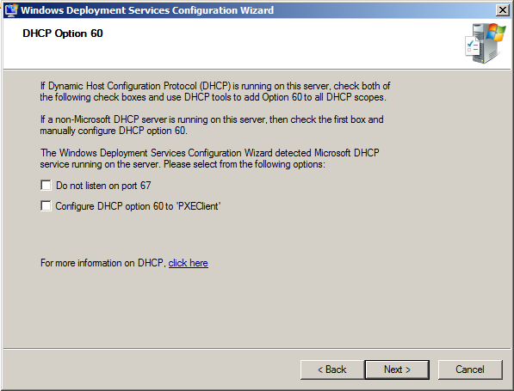
WDS and DHCP

Slide 9
Windows Imaging Format (WIM)
File-based disk image format
Contains files
Contains associated file system metadata
Developed by Microsoft
Windows boot loader supports booting WIM
Windows Setup DVD uses such WIM files

Slide 10
Automating Deployment
Windows AIK
The Automated Installation Kit (Windows AIK) is a set of tools and documentation that support the configuration and deployment of Windows client and server operating systems.
Windows AIK can be used to automate:
Windows installations
Capture Windows images
Configure and modify images
Create Windows PE images
Migrate user profiles and data

Slide 11
Windows AIK
Sysprep
Windows System Image Manager(SIM)
User State Migration Tool
Windows PE tools
ImageX
Deployment Image Servicing and Management Tool (DISM)
BCDboot.exe

Slide 12
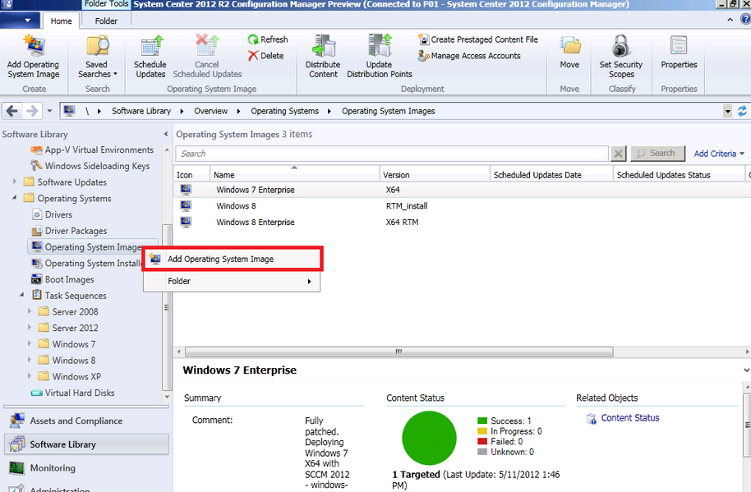
System Center Configuration Manager (SCCM)

Slide 13
Automating Windows Deployment
http://academy.telerik.com

Slide 14




Free Trainings @ Telerik Academy
"Web Design with HTML 5, CSS 3 and JavaScript" course @ Telerik Academy
html5course.telerik.com
Telerik Software Academy
academy.telerik.com
Telerik Academy @ Facebook
facebook.com/TelerikAcademy
Telerik Software Academy Forums
forums.academy.telerik.com

